Slide 1
Rest laid plans of mice and men:
Strategies for testing your APIs so you look like a wizard

Slide 2
Thanks, Sponsors!

Slide 3
Your presenter: Ryan Cox
Seven (?!) years’ experience being PAID to BREAK THINGS!
Discovery Quality Engineer for the last four years, focused on automated testing processes and integrating into CI build process.
Husband, father, geek, perpetual n00b.
Twitter: @coxrya
Knox Devs Slack
Linkedin

Slide 4
What is REST?
Representational State Transfer
Architecture based on HTTP, or Hypertext Transfer ssssnnnnn……
Communication between computer systems, initiates operations, manipulates data, etc.
Stateless – I don’t have to know where you are in your process

Slide 5
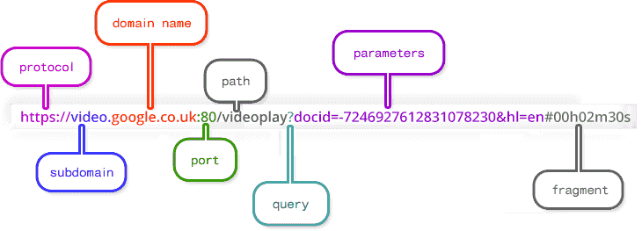
Anatomy of an HTTP Request

Slide 6
Anatomy pt2
Query Parameters:
http://exampledomain.com/resource?propertyName=propertyValue&otherPropertyName=notTheSameValue
Path Parameters:
http://exampledomain.com/resource/{id}

Slide 7
Actions to perform:
GET
Requests a representation of a given resource
Should only retrieve data and not perform any other action.
Navigating to any webpage in the browser executes a GET.

Slide 8
Actions to perform:
PUT
Requests that the body be stored under the provided resource. If it already exists, replace it. If it doesn’t, create it.

Slide 9
Actions to perform
POST
Create a new entity as subordinate of the resource.
Can also be used to initiate actions

Slide 10
Actions to perform
DELETE
Removes the resource specified.
Ex., http://exampledomain.com/resource/3

Slide 11
Status codes
200 = OK
201 = CREATED
202 = ACCEPTED
204 = NO CONTENT
302 = REDIRECT FOUND
404 = NOT FOUND
405 = METHOD NOT ALLOWED
400 = BAD REQUEST
401 = UNAUTHENTICATED
403 = FORBIDDEN
500 = INTERNAL SERVER ERROR

Slide 12
TESTING!
Define expectations
What’s the functionality supposed to do? (Happy path)
What’s it NOT supposed to do? (Negative Scenarios)
Any areas for weakness?
Check expected data types, character limits, etc.
What happens if you give it null values?

Slide 13
TESTING!
Get your tools
Manual Testing
Postman or other client
Automation
RestAssured
Jersey Client
Geb/Spock

Slide 14
TESTING!
Create your payload
Utilize POJOs!
Deserializing JSON or XML into a java object enhances readability and extensibilitly.
Swagger Documentation
Saved Requests

Slide 15
TESTING!
Be aware of the mess you leave.
How can bad test data affect your environment?
Should you create your own assets or use existing ones? (It depends)
Best case scenario:
Leave only footprints.
Actually, clean those up too.

